Slide 1
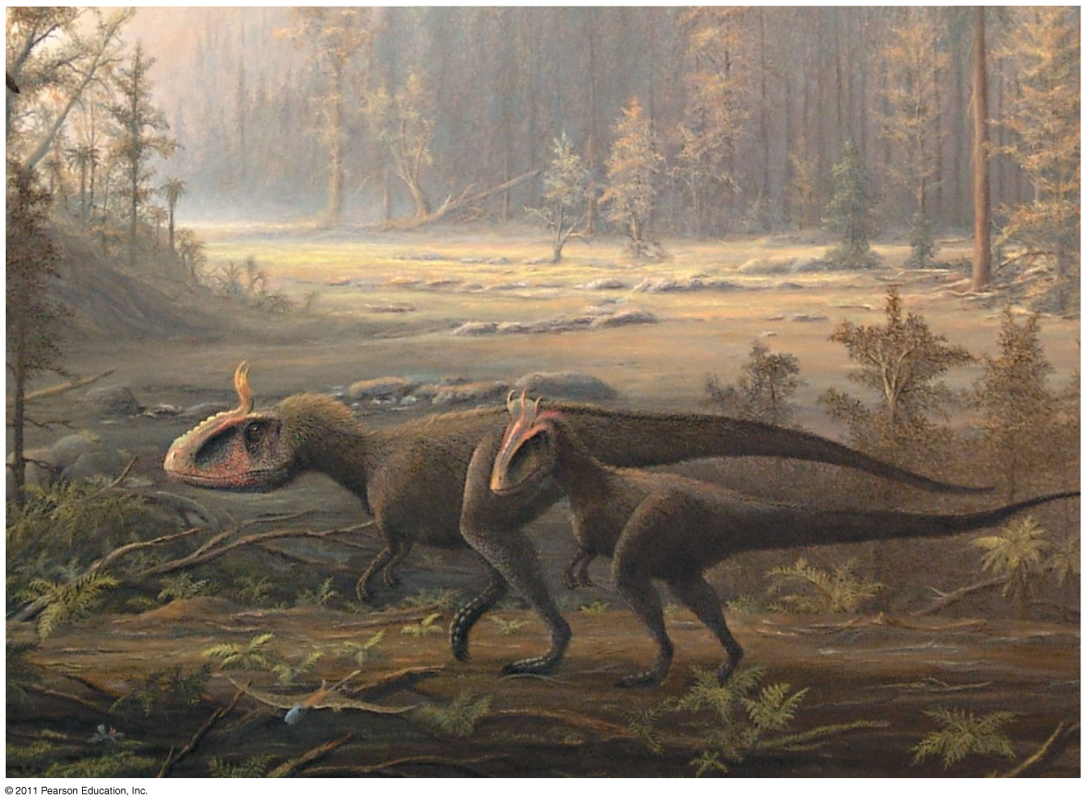
Chapter 25
The History of Life on Earth

Slide 2
What you need to know:
A scientific hypothesis about the origin of life on Earth.
The age of the Earth and when prokaryotic and eukaryotic life emerged.
Characteristics of the early planet and its atmosphere.
How Miller & Urey tested the Oparin-Haldane hypothesis and what they learned.
Methods used to date fossils and rocks and how fossil evidence contributes to our understanding of changes in life on Earth.
Evidence for endosymbiosis.
How continental drift can explain the current distribution of species.
How extinction events open habitats that may result in adaptive radiation.

Slide 3
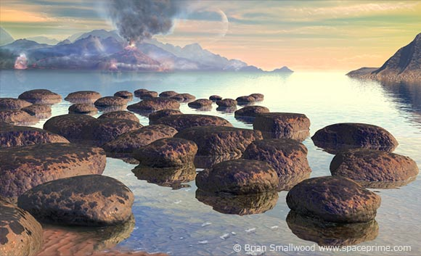
Early conditions on Earth

Slide 4
Earth = 4.6 billion years old
First life forms appeared ~3.8 billion years ago
How did life arise?
Small organic molecules were synthesized
Small molecules → macromolecules (proteins, nucleic acids)
Packaged into protocells (membrane-containing droplets)
Self-replicating molecules allow for inheritance
“RNA World”: 1st genetic material most likely RNA
First catalysts = ribozymes (RNA)

Slide 5
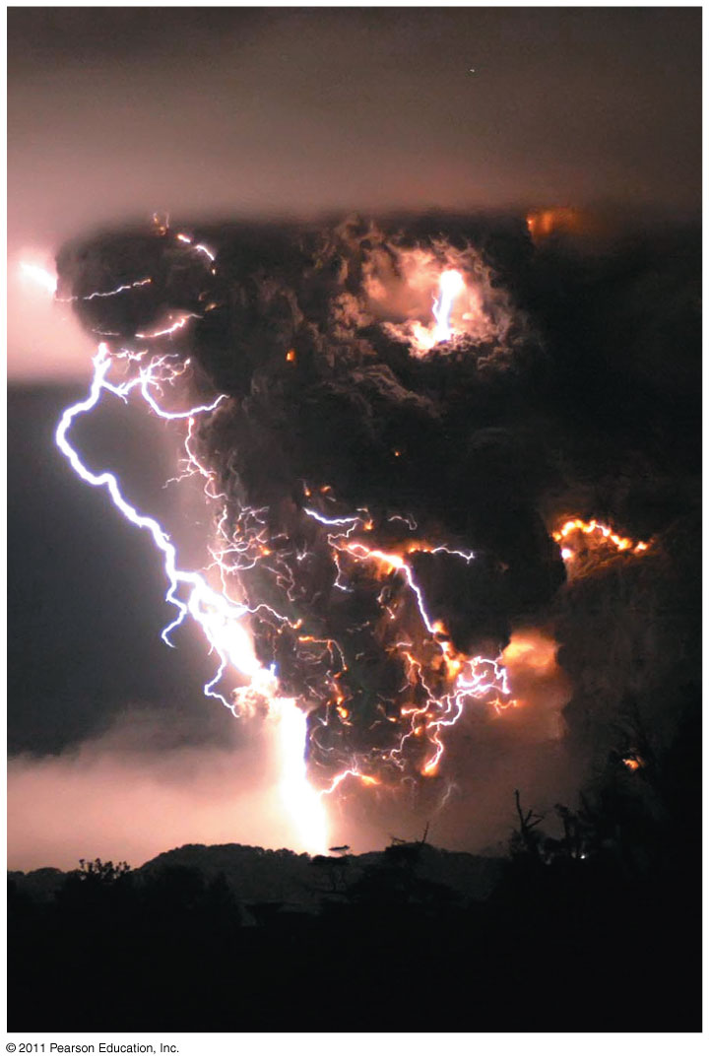
Synthesis of Organic Compounds on Early Earth
Oparin & Haldane:
Early atmosphere = H₂O vapor, N₂, CO₂, H₂, H₂S methane, ammonia
Energy = lightning & UV radiation
Conditions favored synthesis of organic compounds - a “primitive soup”

Slide 6
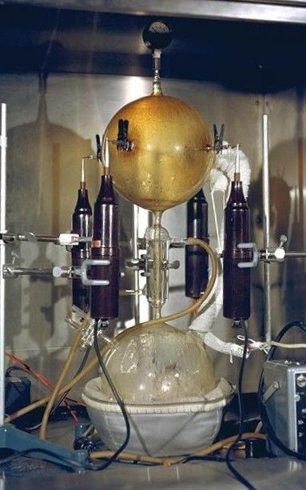
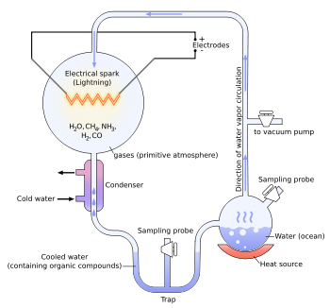
Miller & Urey:
Tested Oparin-Haldane hypothesis
Simulated conditions in lab
Produced amino acids

Slide 7
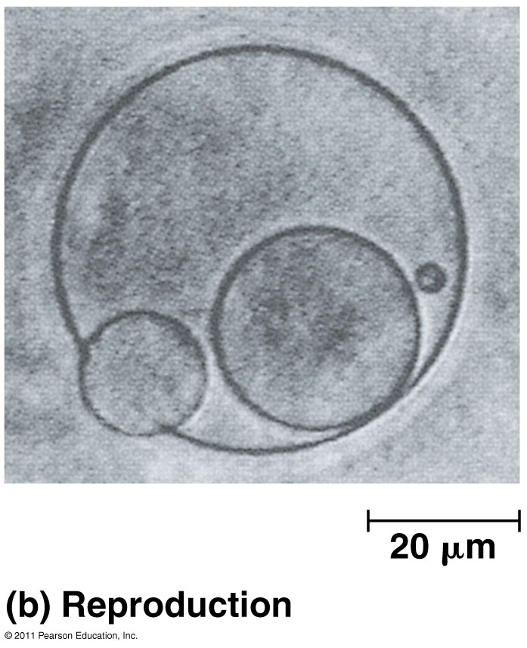
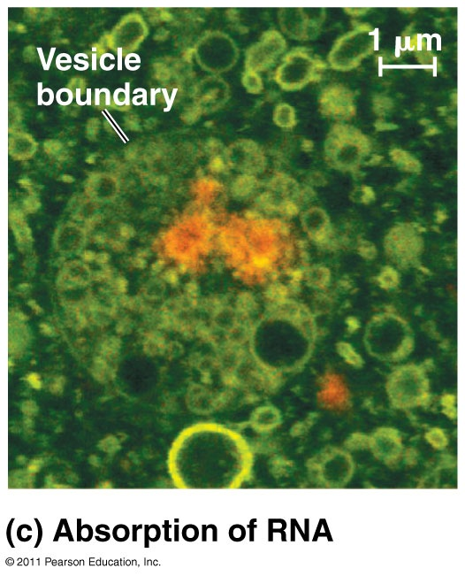
Protocells & Self-Replicating RNA

Slide 8
Sedimentary rock (layers called strata)
Mineralized (hard body structures)
Organic – rare in fossils but found in amber, frozen, tar pits
Incomplete record – many organisms not preserved, fossils destroyed, or not yet found

Slide 9
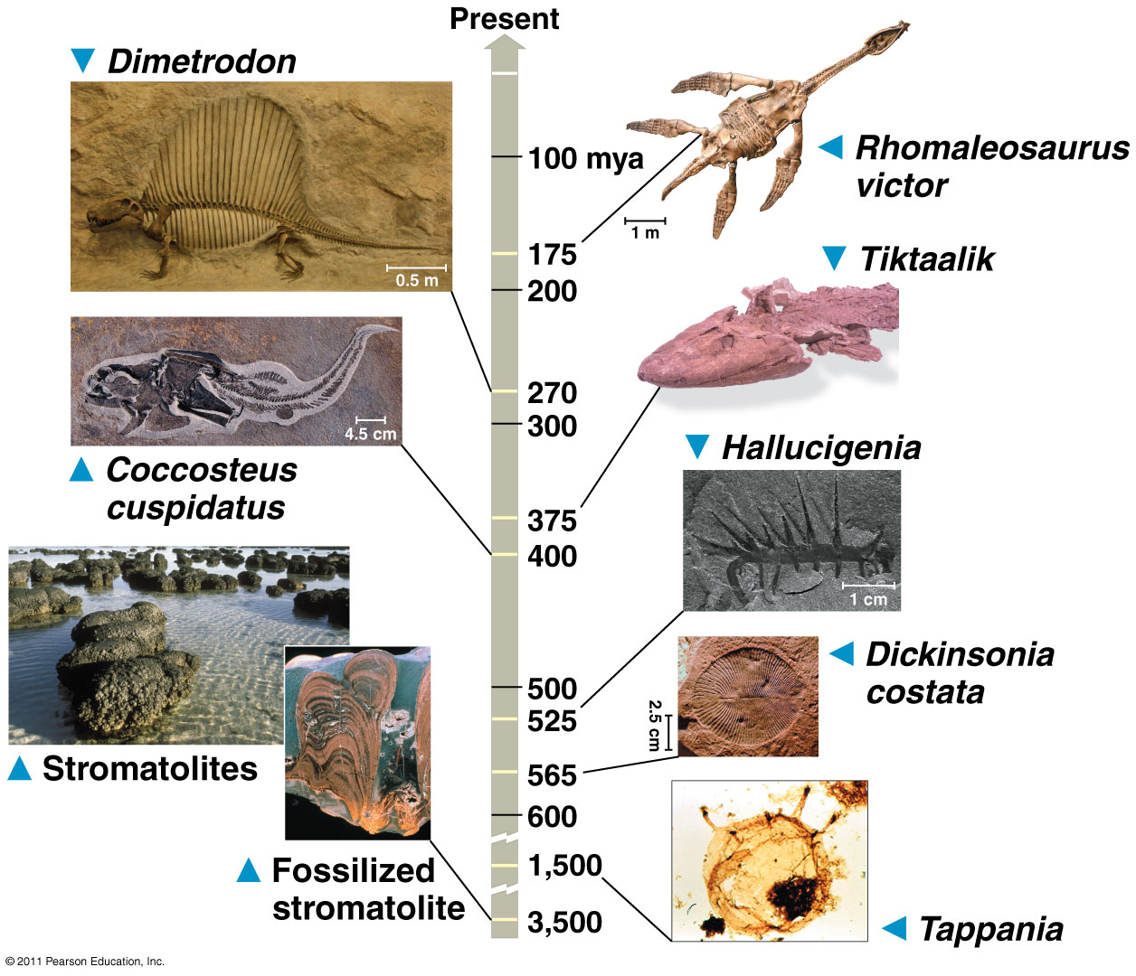

Slide 10
Relative Dating
Radiometric Dating
Uses order of rock strata to determine relative age of fossils
Measure decay of radioactive isotopes present in layers where fossils are found
Half-life: # of years for 50% of original sample to decay

Slide 11
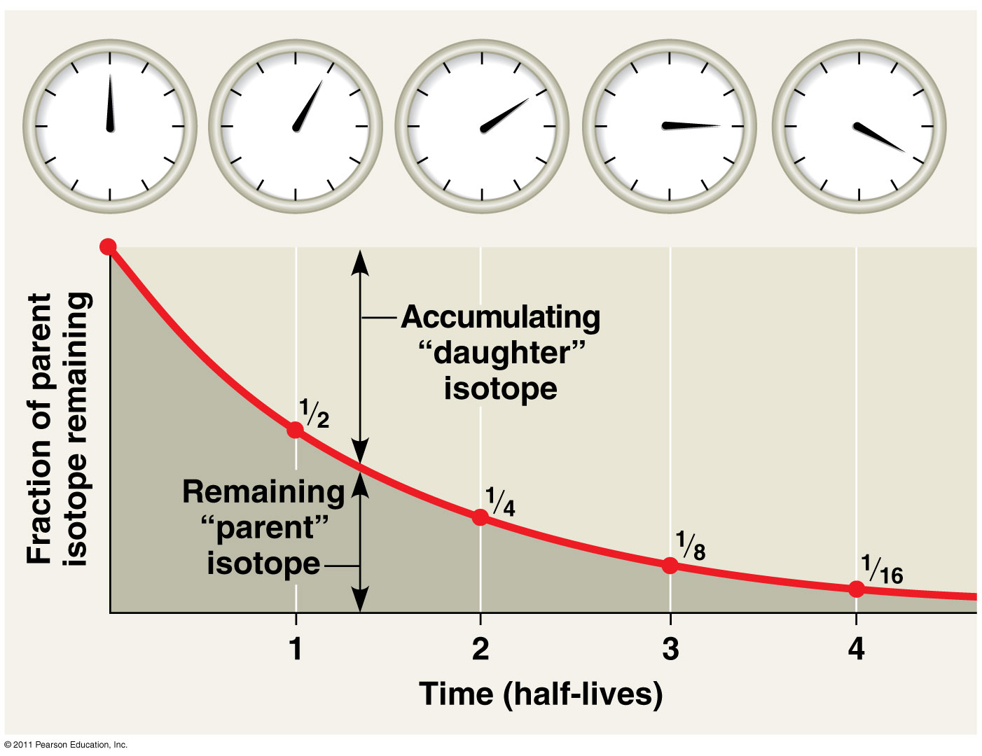

Slide 12
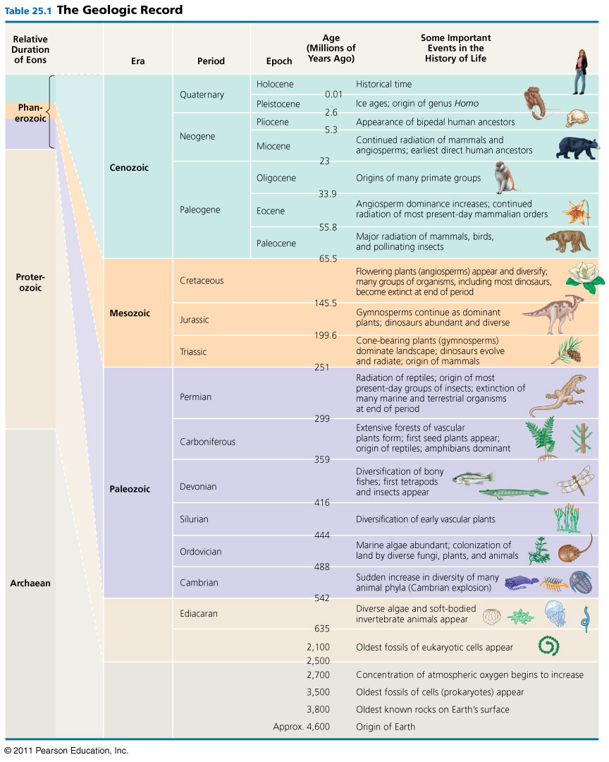
Geologic Time Scale
Eon → Era → Period → Epoch (longest to shortest)
Present Day: Phanerozoic Eon, Cenozoic Era, Quaternary Period, Holocene Epoch

Slide 13
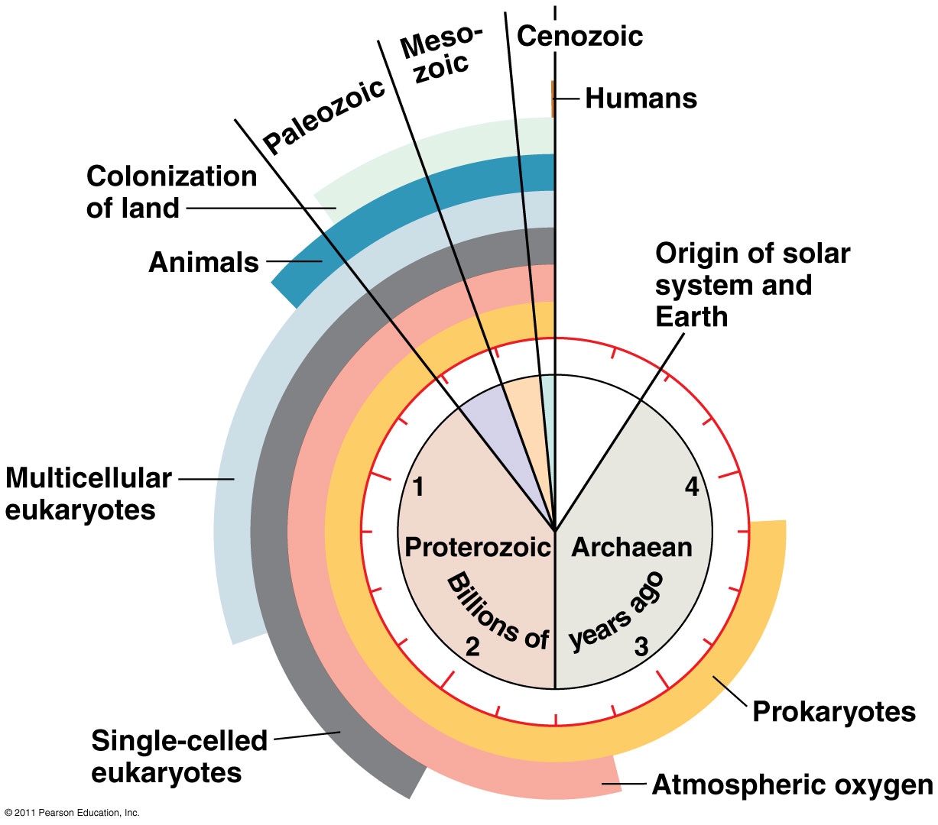

Slide 14
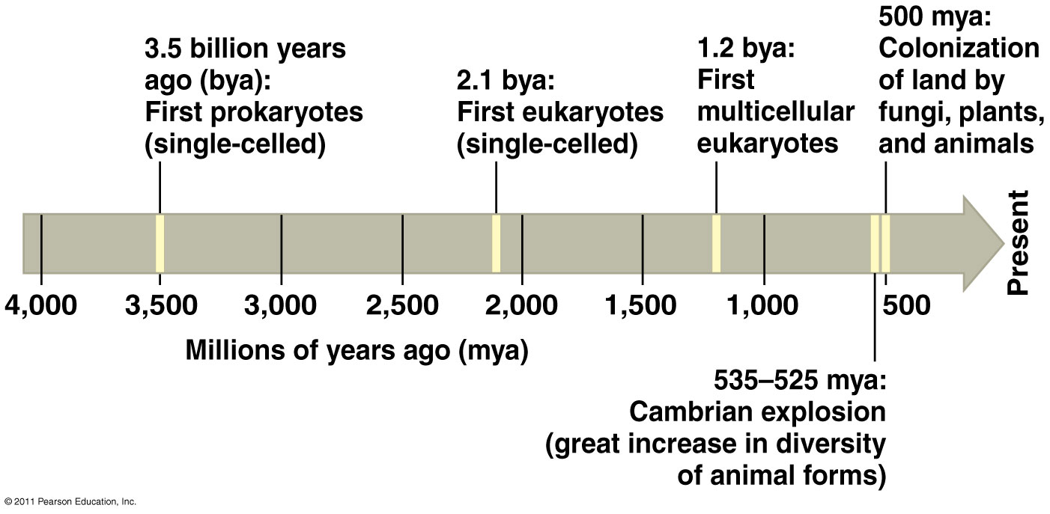
Key Events in Life’s History
O₂ accumulates in atmosphere
(2.7 bya)
Humans
(200,000)

Slide 15
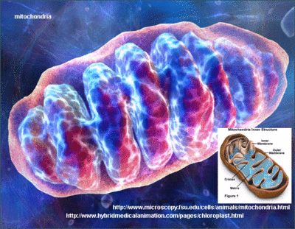
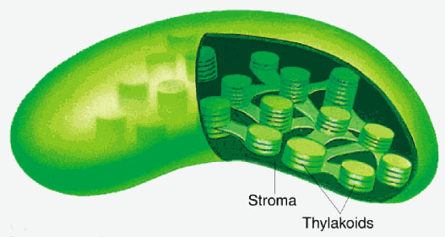
Endosymbiont Theory
Mitochondria & plastids (chloroplasts) formed from small prokaryotes living in larger cells
Evidence:
Replication by binary fission
Single, circular DNA (no histones)
Ribosomes to make proteins
Enzymes similar to living prokaryotes
Two membranes

Slide 16
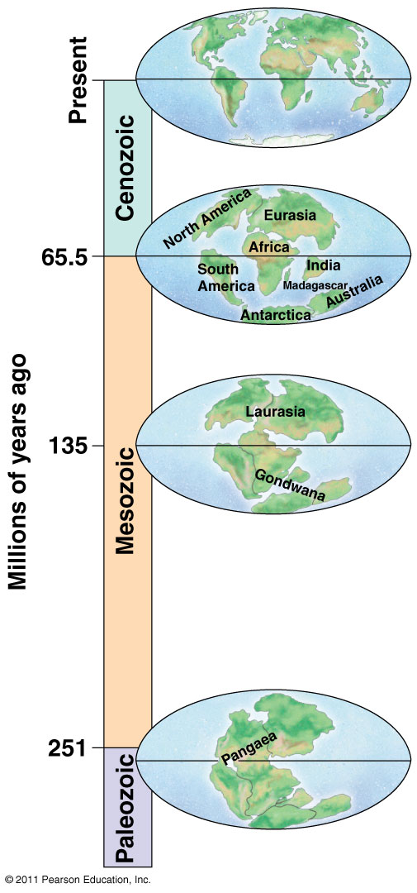
Pangaea = Supercontinent
Formed 250 mya
Continental drift explains many biogeographic puzzles

Slide 17
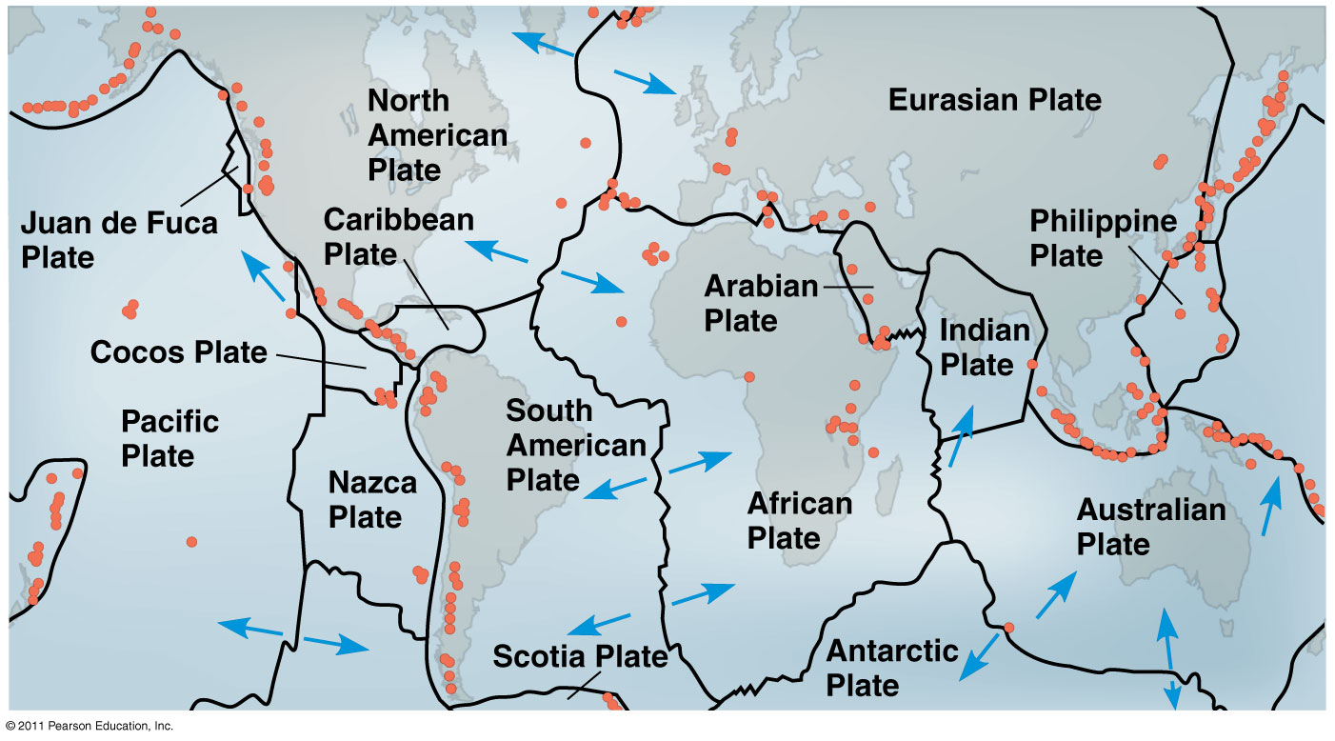
Movement of continental plates change geography and climate of Earth → Extinctions and speciation

Slide 18
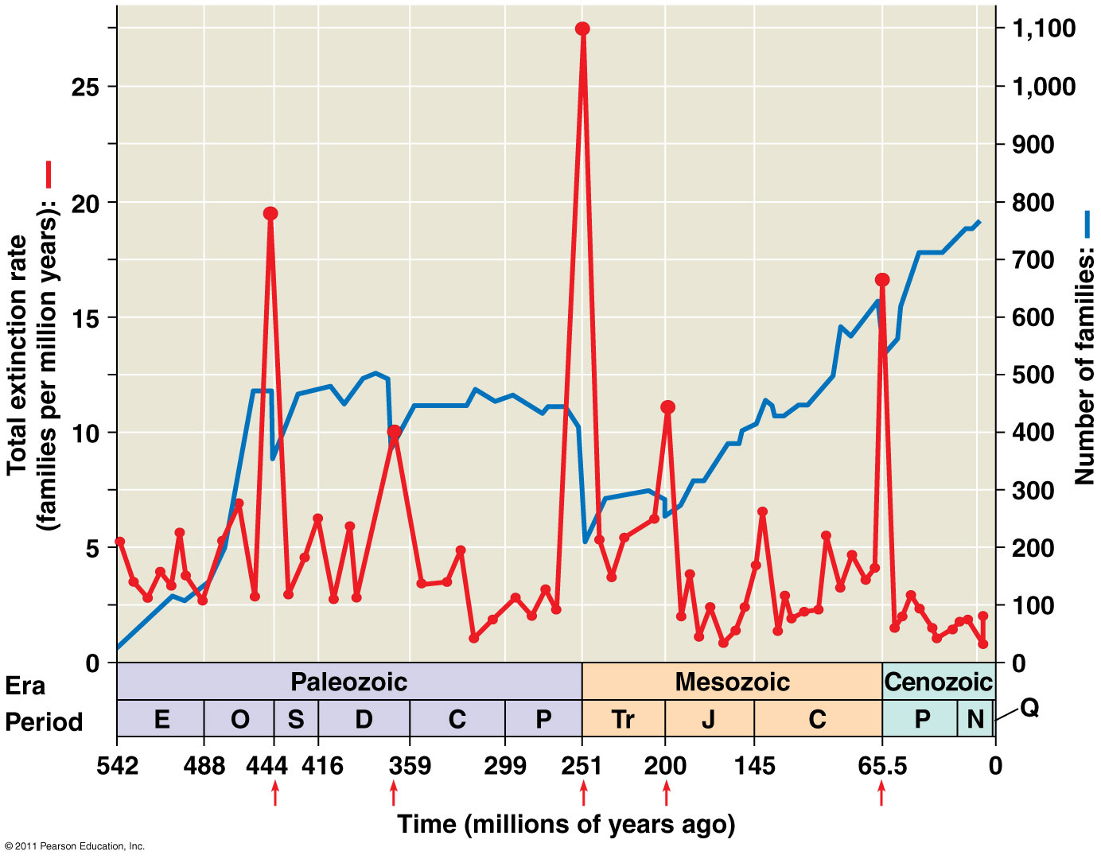
Mass extinctions → Diversity of life
Major periods in Earth’s history end with mass extinctions and new ones begin with adaptive radiations

Slide 19
Major events during each Era
Precambrian: microscopic fossils (stromatolites)
Photosynthesis, atmospheric O₂
Eukaryotes (endosymbiont theory)
Paleozoic: Cambrian Explosion
Plants invade land, many animals appear
Permian Extinction (-96% species)
Mesozoic: “Age of Reptiles”, dinosaur, plants
Formation of Pangaea supercontinent
Cretaceous Extinction – asteroid off Mexico’s coast
Cenozoic: Primates
Note: All end with major extinction & start with adaptive radiation

Slide 20
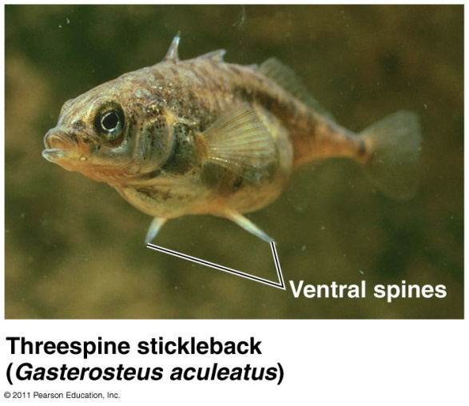
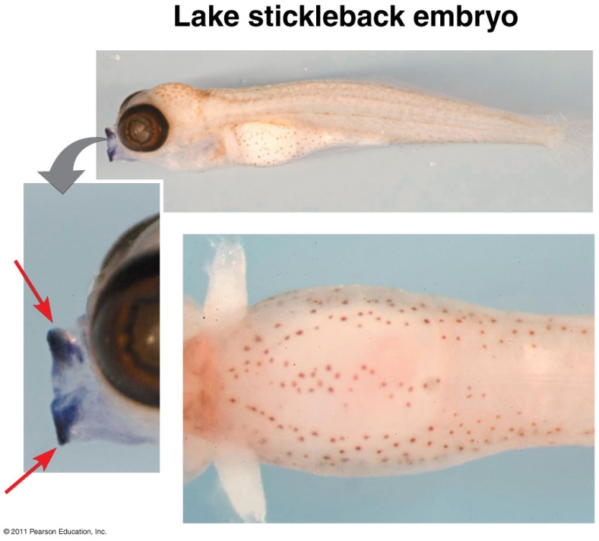
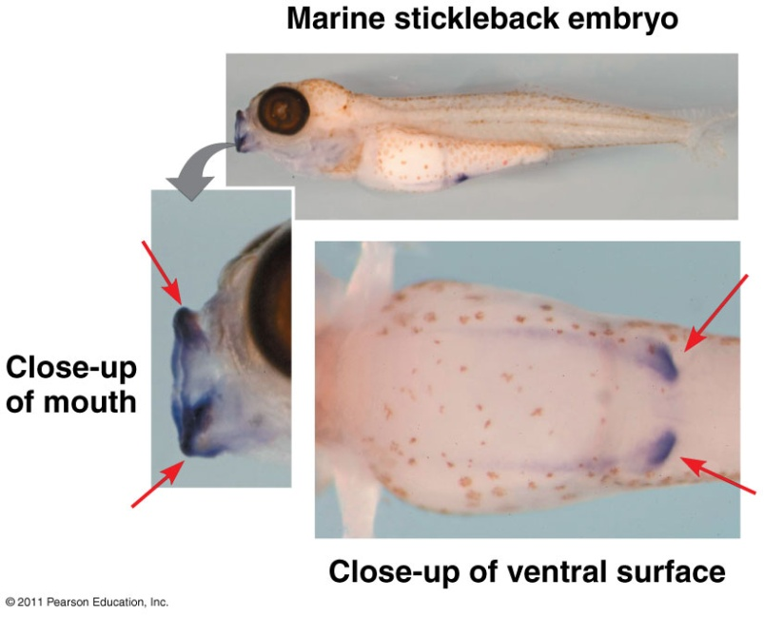
Evo-Devo: evolutionary + developmental biology
Evolution of new forms results from changes in DNA or regulation of developmental genes

Slide 21
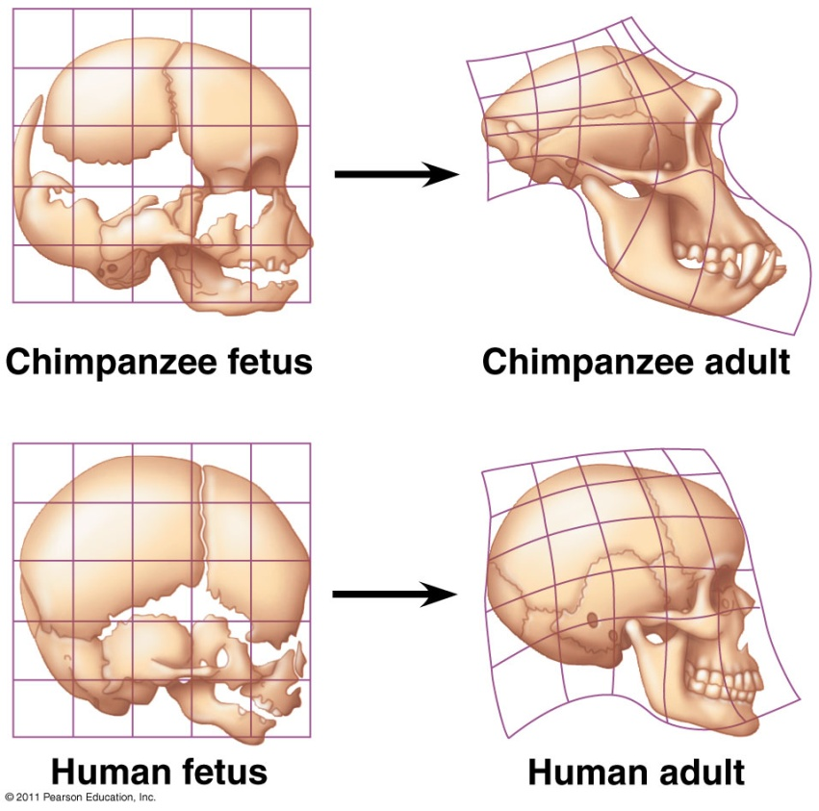
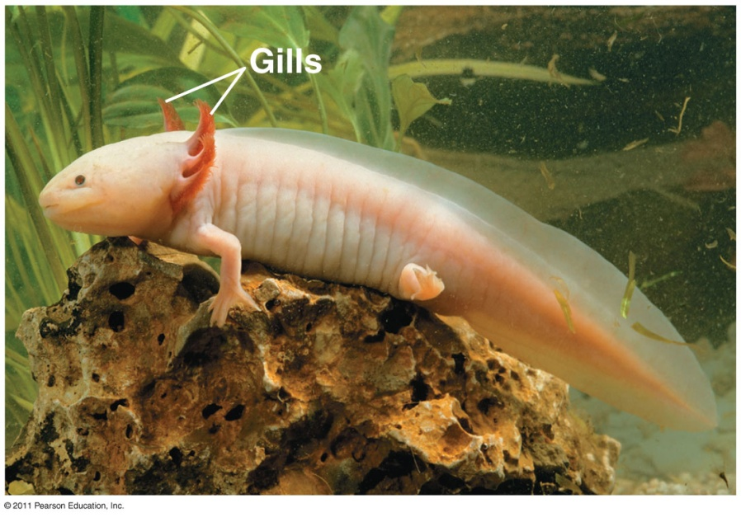
Heterochrony: evolutionary change in rate of developmental events
Paedomorphosis: adult retains juvenile structures in ancestral species

Slide 22
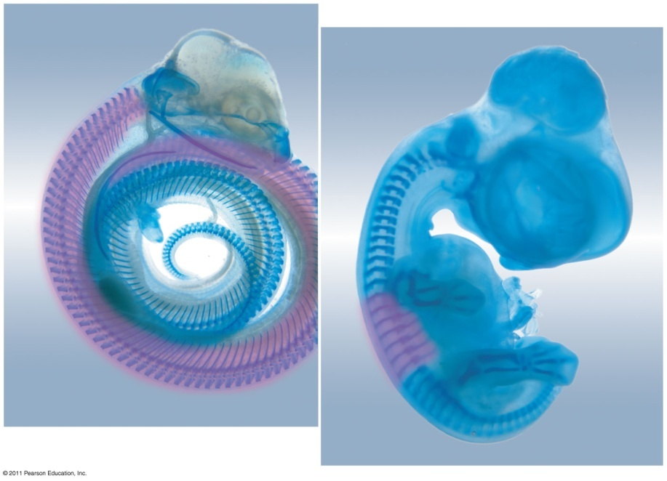
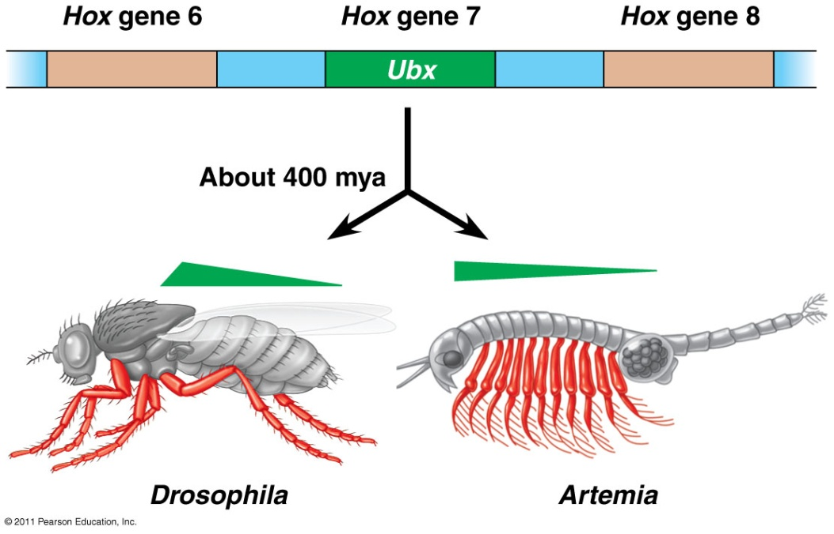
Homeotic genes: master regulatory genes determine location and organization of body parts
Eg. Hox genes
Evolution of Hox genes changes the insect body plan.
Hox gene expression and limb development.

Slide 23
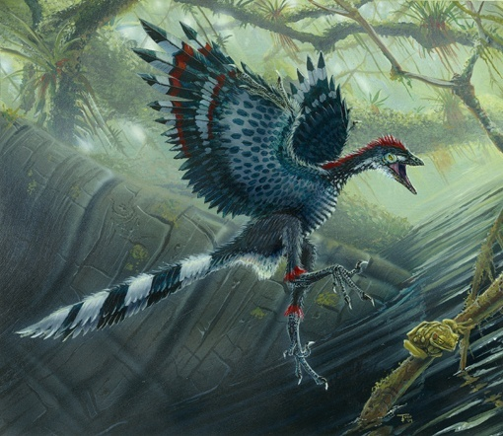
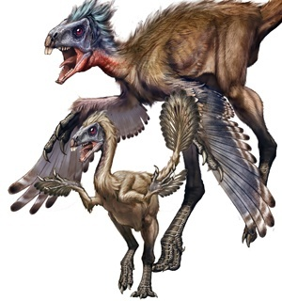
Exaptations: structures that evolve but become co-opted for another function
Eg. bird feathers = thermoregulation → flight

